Slide 1
Predicting the NFL drafts
By: Justin Ellis

Slide 2
Predicting NFL Draft Outcomes Using Machine Learning
This project analyzes NFL Combine data to determine whether machine learning can predict which college football players will be drafted into the NFL
• The NFL Combine provides objective athletic measurements that teams use when evaluating players before the draft
• By training machine learning models on these measurements, it is possible to identify patterns that may influence whether a player is selected in the draft
• Multiple classification algorithms were implemented and evaluated using the same dataset
• The models were trained to recognize relationships between physical performance metrics and draft outcomes
• The final goal of this project was to compare model accuracy and determine which machine learning algorithm produces the most reliable predictions

Slide 3
The Problem Being Solved
• Every year thousands of college football players attempt to enter the NFL through the draft
• NFL teams evaluate players based on many factors including athletic ability measured during the NFL Combine
• While teams rely on scouts coaches and analysts large datasets now allow data science techniques to analyze these decisions as well
• This project investigates whether machine learning models can learn patterns in combine data that indicate whether a player will be drafted
• The task is structured as a binary classification problem where the model must assign players to one of two possible outcomes
• Possible predictions include drafted or not drafted
• The models analyze measurable performance metrics and attempt to predict this outcome as accurately as possible

Slide 4
Dataset Overview
• The dataset used in this project contains NFL Combine performance data for players entering the NFL Draft
• Each row in the dataset represents a single player who participated in the combine
• The dataset includes multiple objective athletic measurements that scouts use to evaluate player performance
• These measurements represent key aspects of athletic ability that are important in professional football
• The dataset includes variables such as height weight 40 yard dash time bench press repetitions vertical jump height broad jump distance shuttle drill time and three cone drill time
• These features provide quantitative measurements of a player's strength speed agility and explosiveness
There are 3477 points of data which are distinct players
https://www.kaggle.com/datasets/redlineracer/nfl-combine-performance-data-2009-2019
NFL Combine results from 2009 to 2019. This single file contains information on sports performance testing results, graduating school, draft outcome, and general demographics.
https://www.pro-football-reference.com/ (The data comes from this link)

Slide 5
Number of Players Analyzed
• The dataset contains all players included in the combine dataset after preprocessing and cleaning
• Each player represents one observation that is used by the machine learning algorithms during training and testing
• Before training the models the dataset was divided into two subsets to evaluate predictive performance
• The data was split into training data and testing data
• Training data makes up eighty percent of the dataset and is used by the algorithms to learn patterns
• Testing data makes up twenty percent of the dataset and is used to evaluate how well the trained model performs on unseen data
• This process ensures that the models are evaluated fairly and prevents them from simply memorizing the training dataset

Slide 6
Features Used by the Models
• Features are the input variables used by machine learning algorithms to make predictions
• In this project only objective numerical measurements from the NFL Combine were used as features
• These metrics represent the player's measurable athletic performance during standardized drills
• The primary features used include height weight forty yard dash time bench press repetitions vertical jump broad jump shuttle time and three cone drill time
• These measurements capture important aspects of athletic performance including speed strength agility and explosiveness
• The models analyze patterns across these metrics to determine how they relate to draft outcomes

Slide 7
Target Variable
• The target variable represents the value the machine learning models are attempting to predict
• In this project the target variable is drafted
• The original dataset labeled players using text values indicating whether they were drafted
• For machine learning purposes these values were converted into numerical labels
• One represents drafted and zero represents not drafted
• This transformation allows the models to perform mathematical calculations and optimize predictions during training
• The models attempt to learn the relationship between combine performance metrics and the probability that a player will be drafted

Slide 8
Feature Selection Process
• Before training the machine learning models several columns were removed from the dataset
• These columns were excluded because they contained text values or information that could bias the predictions
• The removed columns included player school drafted team and round information player type position type and position
• These columns were removed because they contain non numerical text values
• Some of them reveal information about the draft outcome itself
• They also do not directly represent measurable athletic performance
• After removing these variables only numerical performance metrics remained in the dataset

Slide 9
Handling Missing Values
• Some players in the dataset were missing certain combine measurements
• Missing values appear in datasets as NaN which means not a number
• Many machine learning algorithms cannot train when missing values are present
• To resolve this issue the dataset was processed using mean imputation
• Mean imputation replaces missing values with the average value of that column
• For example if a player was missing a vertical jump value the average vertical jump across the dataset was used instead
• This method preserves the dataset size while maintaining the overall statistical structure of the data

Slide 10
Model One Logistic Regression
• The first model used in this project was logistic regression
• Logistic regression is a statistical classification algorithm that estimates the probability that a data point belongs to a particular class
• The model works by fitting a linear boundary that separates the two classes in the dataset
• In this case the boundary separates players predicted to be drafted from those predicted not to be drafted
• Logistic regression was used as a baseline model to evaluate the dataset and establish an initial level of performance
• The model was trained using the training dataset and evaluated using the testing dataset
The accuracy for this model was 72.98%

Slide 11
Model Two HistGradientBoosting
• The second model implemented in this project was the hist gradient boosting classifier
• This algorithm is a gradient boosting method that builds multiple decision trees sequentially
• Each new tree attempts to correct the errors made by previous trees in the model
• By combining many trees together the model can capture complex nonlinear relationships in the dataset
• Hist gradient boosting is particularly effective for structured datasets like sports performance metrics
• The model was trained using the training dataset and evaluated using the testing dataset
The accuracy for this model was 80.4%

Slide 12
Model Three XGBoost
• The third model used was XGBoost which stands for extreme gradient boosting
• XGBoost is a highly optimized implementation of gradient boosting designed for strong performance on structured datasets
• It builds an ensemble of decision trees that work together to improve prediction accuracy
• The algorithm analyzes interactions between multiple features simultaneously
• XGBoost also includes regularization techniques that help prevent overfitting and improve model stability
• The model was trained on the training dataset and evaluated on the testing dataset
The accuracy for this model was 81%

Slide 13
Model Four Support Vector Machine
• The final model tested in this project was the support vector machine classifier
• Support vector machines classify data by identifying the optimal boundary that separates the two classes
• The algorithm attempts to maximize the distance between this boundary and the closest data points from each class
• This allows the model to clearly separate drafted players from undrafted players
• Support vector machines are effective for complex classification problems where patterns are not perfectly linear
• The accuracy for this model was 67.3%

Slide 14
Model Performance Comparison
• After training each model their prediction accuracy was evaluated using the testing dataset
• Accuracy measures the percentage of correct predictions made by the model
• Each algorithm was trained and tested using the same dataset to ensure a fair comparison
• The models produced different levels of predictive accuracy based on how well they captured relationships in the data
• By comparing the results it becomes possible to determine which model performs best for this problem

Slide 15
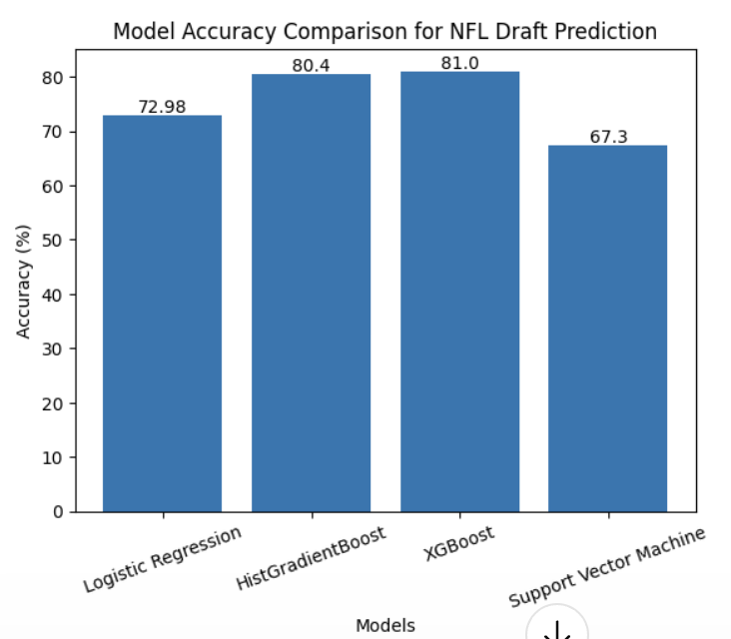
Best Performing Model
• After evaluating all model results XGBoost had the highest accuracy
• This model demonstrated the strongest ability to identify patterns between combine performance metrics and draft outcomes
• It produced the highest percentage of correct predictions on unseen testing data
• Selecting the best model allows the dataset to be used in a way that maximizes predictive reliability

Slide 16
Conclusion
• This project demonstrates how machine learning can be applied to sports analytics
• NFL Combine performance metrics contain measurable information that relates to whether a player will be drafted
• Multiple classification algorithms were trained using these metrics to predict draft outcomes
• Each model learned relationships between athletic measurements and the probability of being drafted
• By comparing model accuracy the most effective algorithm for this dataset was identified
• The results show how data science can be used to analyze athletic performance and generate predictive insights in professional sports

